Slide 1

Transactions
1 | Introduction to Databases (F18): Lecture 11 Query Processing. Transactions, Recovery

Slide 2
Core Transaction Concept is ACID Properties (http://slideplayer.com/slide/9307681)/)
ACID
Atomic
“ALL OR NOTHING”
Transaction cannot be subdivided
Consistent
Transaction → transforms database from one consistent state to another consistent state
Isolated
Transactions execute independently of one another
Database changes not revealed to users until after transaction has completed
Durable
Database changes are permanent
The permanence of the database’s consistent state
Notes:
Consistent:
When transaction commits, DB is moved from one consistent state to another
Isolated:
Simultaneous transactions are not revealed until after transaction completion
Durable:
Result of a transaction is maintained (eg if computer crashes)

Slide 3
ACID Properties (httpwww.tutorialspoint.com/dbms/dbms_transaction.htm)
A transaction is a very small unit of a program and it may contain several low-level tasks. A transaction in a database system must maintain Atomicity, Consistency, Isolation, and Durability − commonly known as ACID properties − in order to ensure accuracy, completeness, and data integrity.
Atomicity − This property states that a transaction must be treated as an atomic unit, that is, either all of its operations are executed or none. There must be no state in a database where a transaction is left partially completed. States should be defined either before the execution of the transaction or after the execution/abortion/failure of the transaction.
Consistency − The database must remain in a consistent state after any transaction. No transaction should have any adverse effect on the data residing in the database. If the database was in a consistent state before the execution of a transaction, it must remain consistent after the execution of the transaction as well.
Durability − The database should be durable enough to hold all its latest updates even if the system fails or restarts. If a transaction updates a chunk of data in a database and commits, then the database will hold the modified data. If a transaction commits but the system fails before the data could be written on to the disk, then that data will be updated once the system springs back into action.
Isolation − In a database system where more than one transaction are being executed simultaneously and in parallel, the property of isolation states that all the transactions will be carried out and executed as if it is the only transaction in the system. No transaction will affect the existence of any other transaction.

Slide 4

Atomicity
4 | Introduction to Databases (F18): Lecture 10 Query Processing. Transactions, Recovery

Slide 5
Atomicity
A transaction is a logical unit of work that must be either entirely completed or entirely undone. (All writes happen or none of them happen)
OK. What does this mean? Consider some pseudo-code
def transfer(source_acct_id, target_acct_id, amount)
Check that both accounts exist.
IF is_checking_account(source_acct_id)
Check that (source_acct.balance-amount) > source_account.overdraft_limit
ELSE
Check that (source_count.balance-amount) >source_account.minimum_balance
Update source account
Update target account.
INSERT a record into transfer tracking table.

Slide 6
Atomicity
A transaction is a logical unit of work that must be either entirely completed or entirely undone. (All writes happen or none of them happen)
OK. What does this mean? Consider some pseudo-code
def transfer(source_acct_id, target_acct_id, amount)
Check that both accounts exist.
IF is_checking_account(source_acct_id)
Check that (source_acct.balance-amount) > source_account.overdraft_limit
ELSE
Check that (source_count.balance-amount) >source_account.minimum_balance
Update source account
Update target account.
INSERT a record into transfer tracking table.
Computer or DB Server fails.

Slide 7
Atomicty
Transaction programs and databases are fast (milliseconds). What are the chances of the failure occurring in the wrong spot?
Well, that doesn’t really matter. If it happens,
Someone lost money and
There is no record off it. Someone is going to very upset.
Even a small server can have thousands of concurrent transactions ➔
There will be corruptions because some transaction will be in the wrong place at the wrong time.
Unless we do something in the DBMS
Because HW and software inevitably fail
And sadly, SW is especially prone to failure when under load
Notes:
SQL:
BEGIN TRANSACTION;
blah
blah
blah
COMMIT [or ROLLBACK];
>BEGIN TRANSACTION: starts a transaction, but doesn’t update the DB yet
>COMMIT: use to indicate transaction is ok and goes through, so that DB is updated
>ROLLBACK: use when there is an issue with transaction (eg 2 conflicting transactions), goes back to original DB state before transaction
ATOMICITY: after COMMIT/ROLLBACK, either all transactions happened, or none did.

Slide 8
Atomicity
OK. That stored procedure runs in milliseconds. What are the chances of the failure occurring there?
Well, that doesn’t really matter. If it happens,
Someone lost money and
There is no record off it. Someone is going to very upset.
Even a small server can have thousands of concurrent transactions ➔
There will be corruptions because some transaction will be in the wrong place at the wrong time.
Unless we do something in the DBMS
Because HW and software inevitably fail
And sadly, SW is especially prone to failure when under load

Slide 9
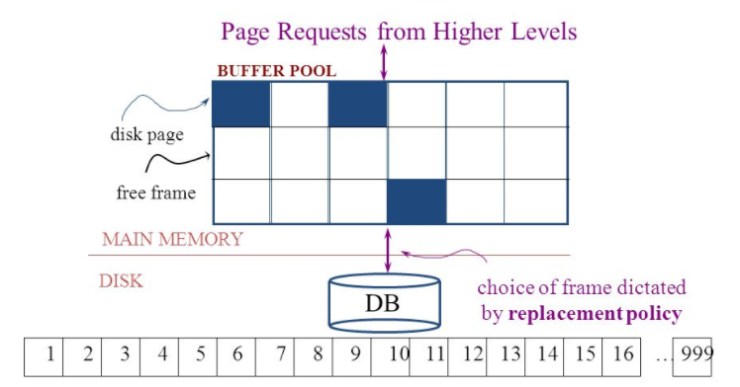
Simplistic Approach
Begin
Update A
Update B
Update C
Commit (REQ)
Force to disk
Commit (RSP)

Slide 10
Simplistic Approach
There are several problems with the simplistic approach.
The approach does not solve the problem
Some write might succeed.
Some might be interrupted by the failure, or require retry.
Writes may be random and scattered. N updates might
Change a few bytes in N data frames (but must write whole block)
A few bytes in M index frames
Transaction rate becomes bottlenecked by write I/O rate, even though a relative small number of bytes change/transaction.
Written frames must be held in memory.
Lots of transactions
Randomly writing small pieces of lots of frames.
Consumes lots of memory with pinned pages.
Degrades the performance and optimization of the buffer.
The optimal buffer replacement policy wants to hold frames that will be reused.
Not frames that have been touched and never reused.
Notes:
3. Can’t remove updated frames from memory until transaction commits to DB

Slide 11
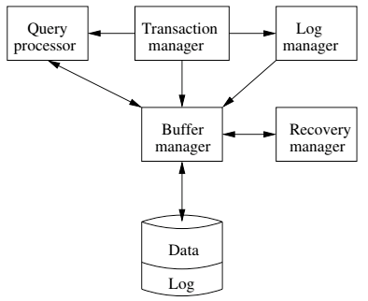
DBMS ACID Implementation
Implementation Subsystems
Query processor schedules and executes queries.
Buffer manager controls reading/writing blocks/frames to/from disk.
Log manager journals/records events to disk (log), e.g.
Transaction start/commit/abort
Transaction update of a block and previous value of data.
Transaction manager coordinates query scheduling, buffer read/write and logging to ensure ACID.
Recovery manager processes log to ensure ACID even after transaction or system failures.
Log is a special type of block file used by the system to optimize performance and ensure ACID.
Garcia-Molina et al., p. 846
Notes:
Log manager: only writes changes in a block, not whole block
Block #
Offset
Old data
New data

Slide 12
Logging
The DBMS logs every transaction event
Log Sequence Number (LSN): A unique ID for a log record.
Prev LSN: A link to their last log record.
Transaction ID number.
Type: Describes the type of database log record.
Update Log Record
PageID: A reference to the Page ID of the modified page.
Length and Offset: Length in bytes and offset of the page are usually included.
Before and After Images of records.
Compensation Log Record
Commit Record
Abort Record Checkpoint Record
Completion Record notes that all work has been done for this particular transaction.

Slide 13
Write Ahead Logging
DBMS (Redo processing)
Write log events from all transactions into a single log stream.
Multiple events per page
Forces (writes) log record on COMMIT/ABORT
Single block I/O records many updates
Versus multiple block I/Os, each recording a single change.
All of a transaction’s updates recorded in one I/O versus many.
If there is a failure
DBMS sequentially reads log.
Applies changes to modified pages that were not saved to disk.
Then resumes normal processing.
Begin
Update A
Update B
Update C
Commit (REQ)
Force to disk
Commit (RSP)
Log
Notes:
When log page is full, or COMMIT/ABORT happens, can force the log to disk
In event of failure:
Look through log for changes that were COMMITTED, but NOT WRITTEN TO DISK → WRITE them to disk

Slide 14
Write Ahead Logging
Force every write to disk?
Poor response time.
But provides durability.
Steal buffer-pool frames from uncommitted transactions?
If not, poor performance/caching performance
If yes, how can we ensure atomicity? Uncommitted updates on disk
DBMS (Undo processing)
Enable steal policy to improve cache performance by
Avoiding lots of pinned pages
Unlikely to be reused soon.
Before stealing
Force log record to disk.
Update log entry has data record
Before image
After image
If there is a failure
DBMS sequentially reads log.
Undoes changes to
modified pages, uncommitted pages
That were saved to disk.
Then resumes normal processing.
No Steal
Steal
Force
Trivial
No Force
Desired
More efficient
Notes:
Force policy:
REDO processing?
Steal policy: what to do with uncommitted pieces of data?
Steal: If need memory, write uncommitted data to disk and free the block in memory
Requires UNDO policy during recovering

Slide 15
ARIES Algorithm = Algorithms for Recovery and Isolation Exploiting Semantics
ARIES recovery involves three passes
Analysis pass:
Determine which transactions to undo
Determine which pages were dirty (disk version not up to date) at time of
RedoLSN: LSN from which redo should start
Redo pass:
Repeats history, redoing all actions from RedoLSN (updated committed but not written changes to pages)
RecLSN and PageLSNs are used to avoid redoing actions already reflected on page
Undo pass:
Rolls back all incomplete transactions (with uncommitted pages written to disk).
Transactions whose abort was complete earlier are not undone

Slide 16
Durability
16 | Introduction to Databases (F18): Lecture 10 Query Processing. Transactions, Recovery

Slide 17
Durability
Write changes to disk trivially achieves durability.
DBMS engine uses write-ahead-logging to
Achieve durability
But with better performance through more efficient caching and I/O.
Well, disks fail. How is that durable.
RAID and other solutions.
Disk subsystems, including entire RAID device, fail →
Duplex writes
To independent disk subsystems.
Well, there are earthquakes, floods, etc.

Slide 18
Availability and Replication
There are two basic patterns
Active/Passive
All requests go to master during normal processing.
Updates are transactionally queued for processing at passive backup.
Failure of master
Routes subsequent requests to backup.
Backup must process and commit updates before accepting requests.
Active/Active
Both environments process requests.
Some form of distributed transaction commit required to synchronize updates on both copies.
Multi-system communication to guarantee consistency is the foundation for tradeoffs in CAP.
The system can be CAP if and only iff
There are never any partitions or system failures
Which is unrealistic in cloud/Internet systems.
Notes:
Have DB in 2 different places. Types:
1 active, 1 passive
Ship changes from active to passive when transaction commits
Both active

Slide 19
Isolation
19 | Introduction to Databases (F18): Lecture 10 Query Processing. Transactions, Recovery

Slide 20
Locking and Concurrency
Application code requires a “processor/CPU” to execute.
The operating system (or execution server) allocates the CPU to a program/subprogram that is ”ready to run,” e.g.
Not waiting for an I/O to complete.
Not waiting for user input.
etc.
The operating system suspends a program and reassigns a CPU when the application performs a blocking operation, e.g.
Make a remote function call.
A disk I/O is necessary.
The program must wait for a physical or logical resource, e.g. “a lock.”
Acquiring a database lock is (potentially) a blocking operation that suspends the application until the lock request is satisfied.
Notes:
Analogy: many people editing 1 Google sheet
Note: from outside (eg Activity Monitor), looks like everything is running at the same time, but really runs are starting and suspending
Unpredictable order of transactions

Slide 21
Multitasking
In computing, multitasking is the concurrent execution of multiple tasks (also known as processes) over a certain period of time. New tasks can interrupt already started ones before they finish, instead of waiting for them to end. As a result, a computer executes segments of multiple tasks in an interleaved manner, while the tasks share common processing resources such as central processing units (CPUs) and main memory. Multitasking automatically interrupts the running program, saving its state (partial results, memory contents and computer register contents) and loading the saved state of another program and transferring control to it. This "context switch" may be initiated at fixed time intervals (pre-emptive multitasking), or the running program may be coded to signal to the supervisory software when it can be interrupted (cooperative multitasking).
Operating system allocates the CPU to one “ready to run” process at a time. The OS performs a context switch periodically, or when the process performs a non-CPU operation, e.g. I/O, wait for a message.

Slide 22
Multi-threading
In computer architecture, multithreading is the ability of a central processing unit (CPU) (or a single core in a multi-core processor) to execute multiple processes or threadsconcurrently, supported by the operating system. This approach differs from multiprocessing. In a multithreaded application, the processes and threads share the resources of a single or multiple cores, which include the computing units, the CPU caches, and the translation lookaside buffer (TLB).
Where multiprocessing systems include multiple complete processing units in one or more cores, multithreading aims to increase utilization of a single core by using thread-level parallelism,

Slide 23
Locking
Transaction Manager
Intercepts all database operations.
Acquires/checks locks on
Records
Pages
Index pages
Suspends and queues an operation
In another active, executing op.
Has a conflicting lock.
Restarts queued operations when conflicting locks are released.
Garcia-Molina et al., p. 846
Notes:
Transaction manager locks block before doing a write
Any queries on that block is suspended until write completes.

Slide 24
Applications and Database Servers
Database
Management
System
(Instance)
“Client” App 2
“Client” App …
A lot of these actions happen implicitly or via defaults, e.g. autocommit.
You have to take explicit steps to bypass and used some of the functions.
Applications connect to a database (server) engine. An application may have one or more connections.
A connection may have one or more simultaneous sessions.
A session may have one or more active cursors.
Applications execute SQL statements on a cursor.
An application may begin, commit and abort transactions on a session.
An application may set an isolation level for a connection or session.

Slide 25
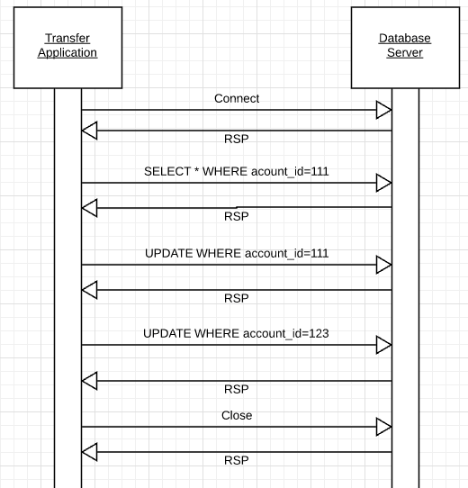
Isolation
Transfer $50 from
account_id=111 to
account_id=123
Requires 3 SQL statements
SELECT from 111 to check balance >= $50
UPDATE account_id=111
UPDATE account_id=123
There are some interesting scenarios
Two different programs read the balance ($51)
And decide removing $50 is OK.
DB constraints can prevent the conflict from happening, but …
There are more complex scenarios that constraints do not prevent.
Not ALL databases support constraints.
The “correct” execution should be that
One transaction responds “insufficient funds”
Before attempting transfer instead of after attempting.
Multiple readers

Slide 26
Isolation
Consider two simultaneous transfer transactions T1 and T2.
There are two equally correct executions
T1 transfers, T2 responds “insufficient funds” and does not attempt transfer
T2 transfers, T1 responds “insufficient funds” and does not attempt transfer
Each correct simultaneous execution is equivalent to a serial (sequential) execution schedule
(1) Execute T1, Execute T2
(2) Execute T2, Execute T1
NOTE:
We are focusing on correctness not
Fairness:
We do not care which transaction was actually submitted first.
And probably do not know due to networking, etc.
Transfer $50 from
account_id=111 to
account_id=123
Requires 3 SQL statements
SELECT from 111 to check balance >= $50
UPDATE account_id=111
UPDATE account_id=123
There are some interesting scenarios
Two different programs read the balance ($51)
And decide removing $50 is OK.
DB constraints can prevent the conflict from happening, but …
There are more complex scenarios that constraints do not prevent.
Not ALL databases support constraints.
The “correct” execution should be that
One transaction responds “insufficient funds”
Before attempting transfer instead of after attempting.
Multiple readers

Slide 27
Serializability
“In concurrency control of databases,^{[1][2]} transaction processing (transaction management), and various transactional applications (e.g., transactional memory^{[3]} and software transactional memory), both centralized and distributed, a transaction schedule is serializable if its outcome (e.g., the resulting database state) is equal to the outcome of its transactions executed serially, i.e. without overlapping in time. Transactions are normally executed concurrently (they overlap), since this is the most efficient way. Serializability is the major correctness criterion for concurrent transactions' executions. It is considered the highest level of isolation between transactions, and plays an essential role in concurrency control. As such it is supported in all general purpose database systems.” (https://en.wikipedia.org/wiki/Serializability)

Slide 28
DBMS ACID Implementation
Implementation Subsystems
Query processor schedules and executes queries.
Buffer manager controls reading/writing blocks/frames to/from disk.
Log manager journals/records events to disk (log), e.g.
Transaction start/commit/abort
Transaction update of a block and previous value of data.
Transaction manager coordinates query scheduling, buffer read/write and logging to ensure ACID.
Recovery manager processes log to ensure ACID even after transaction or system failures.
Log is a special type of block file used by the system to optimize performance and ensure ACID.
Garcia-Molina et al., p. 846

Slide 29
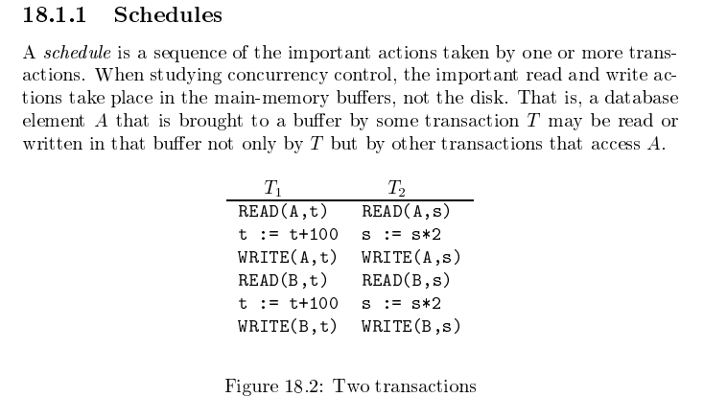
Schedule
Garcia-Molina et al.

Slide 30
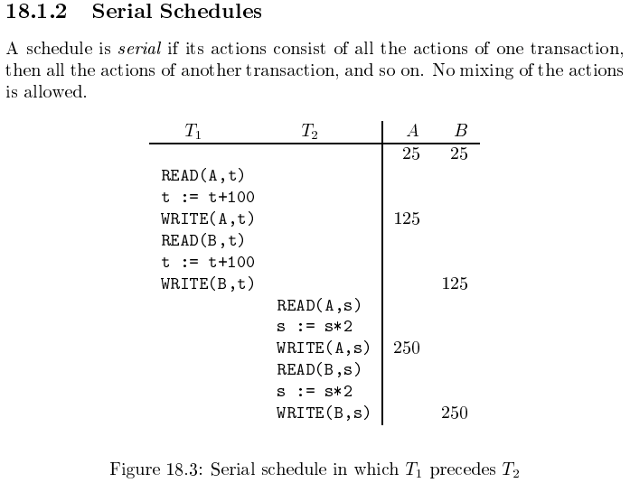
Serializable
Assume there are three
concurrently executing transactions
T1, T2 and T3
The transaction manager
Enables concurrent execution
But schedules individual operations
To ensure that the final DB state
Is equivalent to one of the following schedules
T1, T2, T3
T1, T3, T2
T2, T1, T3
T2, T3, T1
T3, T1, T2
T3, T2, T1
Concurrent execution was serializable.

Slide 31
Serializability (en.wikipedia.org/wiki/Serializability)
Serializability is used to keep the data in the data item in a consistent state. Serializability is a property of a transaction schedule (history). It relates to the isolation property of a database transaction.
Serializability of a schedule means equivalence (in the outcome, the database state, data values) to a serial schedule (i.e., sequential with no transaction overlap in time) with the same transactions. It is the major criterion for the correctness of concurrent transactions' schedule, and thus supported in all general purpose database systems.
The rationale behind serializability is the following:
If each transaction is correct by itself, i.e., meets certain integrity conditions,
then a schedule that comprises any serial execution of these transactions is correct (its transactions still meet their conditions):
"Serial" means that transactions do not overlap in time and cannot interfere with each other, i.e, complete isolation between each other exists.
Any order of the transactions is legitimate, (…)
As a result, a schedule that comprises any execution (not necessarily serial) that is equivalent (in its outcome) to any serial execution of these transactions, is correct.

Slide 32
Lock-Based Concurrency Control
Strict Two-phase Locking (Strict 2PL) Protocol:
Each Xact must obtain a S (shared) lock on object before reading, and an X (exclusive) lock on object before writing.
All locks held by a transaction are released when the transaction completes
(Non-strict) 2PL Variant: Release locks anytime, but cannot acquire locks after releasing any lock.
If an Xact holds an X lock on an object, no other Xact can get a lock (S or X) on that object.
Strict 2PL allows only serializable schedules.
Additionally, it simplifies transaction aborts
(Non-strict) 2PL also allows only serializable schedules, but involves more complex abort processing

Slide 33
Aborting a Transaction
If a transaction Ti is aborted, all its actions have to be undone. Not only that, if Tj reads an object last written by Ti, Tj must be aborted as well!
Most systems avoid such cascading aborts by releasing a transaction’s locks only at commit time.
If Ti writes an object, Tj can read this only after Ti commits.
In order to undo the actions of an aborted transaction, the DBMS maintains a log in which every write is recorded. This mechanism is also used to recover from system crashes: all active Xacts at the time of the crash are aborted when the system comes back up.

Slide 34
Locking
Transaction Manager
Intercepts all database operations.
Acquires/checks locks on
Records
Pages
Index pages
Suspends and queues an operation
In another active, executing op.
Has a conflicting lock.
Restarts queued operations when conflicting locks are released.
Garcia-Molina et al., p. 846

Slide 35
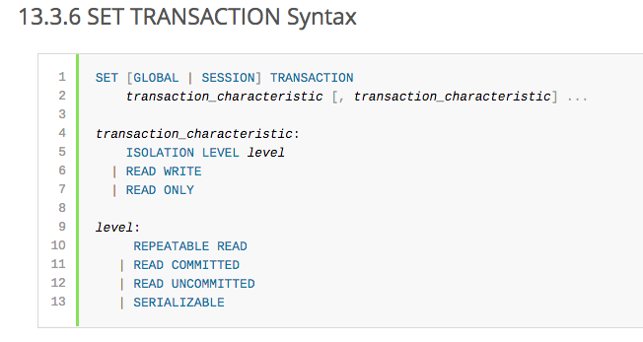
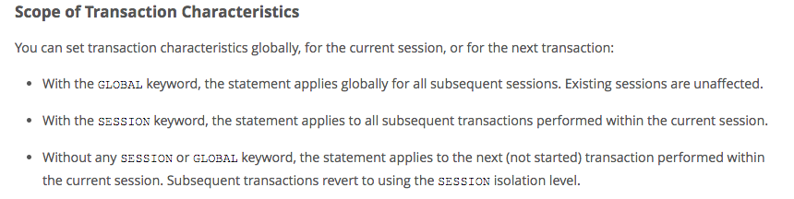
MySQL (Locking) Isolation

Slide 36
Isolation Levels (https://en.wikipedia.org/wiki/Isolation_(database_systems)
Not all transaction use cases require 2PL and serializable execution. Databases support a a set of levels.
Serializable
With a lock-based concurrency control DBMS implementation, serializability requires read and write locks (acquired on selected data) to be released at the end of the transaction. Also range-locks must be acquired when a SELECT query uses a ranged WHERE clause, especially to avoid the phantom reads phenomenon.
The execution of concurrent SQL-transactions at isolation level SERIALIZABLE is guaranteed to be serializable. A serializable execution is defined to be an execution of the operations of concurrently executing SQL-transactions that produces the same effect as some serial execution of those same SQL-transactions. A serial execution is one in which each SQL-transaction executes to completion before the next SQL-transaction begins.
Repeatable reads
In this isolation level, a lock-based concurrency control DBMS implementation keeps read and write locks (acquired on selected data) until the end of the transaction. However, range-locks are not managed, so phantom reads can occur.
Write skew is possible at this isolation level, a phenomenon where two writes are allowed to the same column(s) in a table by two different writers (who have previously read the columns they are updating), resulting in the column having data that is a mix of the two transactions.^{[3][4]}
Read committed
In this isolation level, a lock-based concurrency control DBMS implementation keeps write locks (acquired on selected data) until the end of the transaction, but read locks are released as soon as the SELECT operation is performed (so the non-repeatable reads phenomenon can occur in this isolation level). As in the previous level, range-locks are not managed.
Putting it in simpler words, read committed is an isolation level that guarantees that any data read is committed at the moment it is read. It simply restricts the reader from seeing any intermediate, uncommitted, 'dirty' read. It makes no promise whatsoever that if the transaction re-issues the read, it will find the same data; data is free to change after it is read.
Read uncommitted
This is the lowest isolation level. In this level, dirty reads are allowed, so one transaction may see not-yet-committed changes made by other transactions

Slide 37
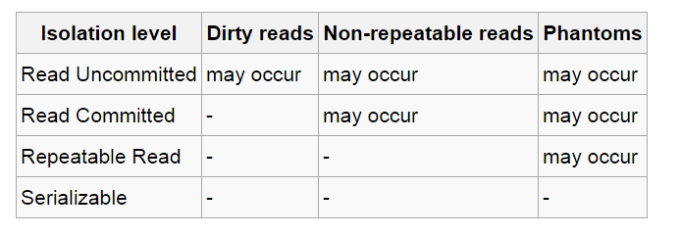
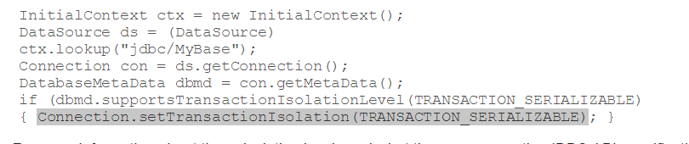
In Databases, Cursors Define Isolation
We have talked about ACID transactions
Atomic: A set of writes all occur or none occur.
Durable: The data “does not disappear,” e.g. write to disk.
Consistent: My applications move the database between consistent states, e.g. the transfer function works correctly.
Isolation
Determines what happens when two or more threads are manipulating the data at the same time.
And is defined relative to where cursors are and what they have touched.
Because the cursor movement determines what you are reading or have read.
But, … Cursors are client conversation state and cannot be used in REST.

Slide 38
Read then Update Conflict
Some
Resource
1. Bob GETs the resource.
3. Bob changes the data based on values.
2. Mary GETs the resource.
If
The written value
Depends on the read value.
The resource may be in the wrong state at the end.
The execution was RRWW
But the intent was RWRW.
4. Mary changes the data based on values.

Slide 39
Isolation/Concurrency Control
There are two basic approaches to implementing isolation
Locking/Pessimistic, e.g. cursor isolation
Optimistic: Before committing, each transaction verifies that no other transaction has modified the data it has read.
How does this work in REST?
The server maintains an ETag (Entity Tag) for each resource.
Every time a resource’s state changes, the server computes a new ETag.
The server includes the ETag in the header when returning data to the client.
The server may optionally maintain and return “Last Modified” time for resources.
Semantics on updates
If-Match – value of a previous calls ETag response used with a PUT or DELETE. Server should only act if nobody else has modified the resource since you last fetched it. Otherwise provides a 412.
If-Modified-Since – value of a previous Last-Modified response used with a GET. Server should only provide a response if the resource was modified since the timestamp submitted. Use in conjunction with If-None-Match in case the change occurred within the same second. Otherwise provide a 304.
If-None-Match – value of a previous calls ETag response used with a GET. Server should only provide a response if the ETag doesn’t match, i.e. the resource has been altered. Otherwise provide a 304.
If-Unmodified-Since – value of a previous Last-Modified response used with a PUT or DELETE. Server should only act if nobody else has modified the resource since you last fetched it. Otherwise provides a 412

Slide 40
Isolation/Concurrency Control
There are two basic approaches to implementing isolation
Locking/Pessimistic, e.g. cursor isolation
Optimistic: Before committing, each transaction verifies that no other transaction has modified the data it has read.
How does this work in REST?
The server maintains an ETag (Entity Tag) for each resource.
Every time a resource’s state changes, the server computes a new ETag.
The server includes the ETag in the header when returning data to the client.
The server may optionally maintain and return “Last Modified” time for resources.
Semantics on updates
If-Match – value of a previous calls ETag response used with a PUT or DELETE. Server should only act if nobody else has modified the resource since you last fetched it. Otherwise provides a 412.
If-Modified-Since – value of a previous Last-Modified response used with a GET. Server should only provide a response if the resource was modified since the timestamp submitted. Use in conjunction with If-None-Match in case the change occurred within the same second. Otherwise provide a 304.
If-None-Match – value of a previous calls ETag response used with a GET. Server should only provide a response if the ETag doesn’t match, i.e. the resource has been altered. Otherwise provide a 304.
If-Unmodified-Since – value of a previous Last-Modified response used with a PUT or DELETE. Server should only act if nobody else has modified the resource since you last fetched it. Otherwise provides a 412

Slide 41
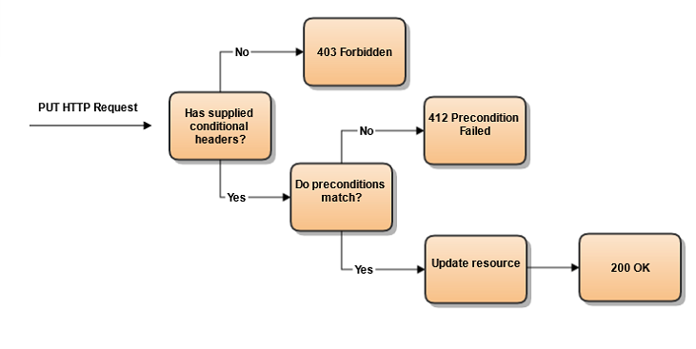
Conditional Processing (https://blog.4psa.com/rest-best-practices-managing-concurrent-updates/)

Slide 42
ETag Processing

Slide 43
Example (Contd.)
Consider a possible interleaving (schedule):
T1: A=A+100, B=B-100
T2: A=1.06*A, B=1.06*B
This is OK. But what about:
T1: A=A+100, B=B-100
T2: A=1.06*A, B=1.06*B
The DBMS’s view of the second schedule:
T1: R(A), W(A), R(B), W(B)
T2: R(A), W(A), R(B), W(B)

Slide 44
Scheduling Transactions
Serial schedule: Schedule that does not interleave the actions of different transactions.
Equivalent schedules: For any database state, the effect (on the set of objects in the database) of executing the first schedule is identical to the effect of executing the second schedule.
Serializable schedule: A schedule that is equivalent to some serial execution of the transactions.
(Note: If each transaction preserves consistency, every serializable schedule preserves consistency. )

Slide 45
Anomalies with Interleaved Execution
Reading Uncommitted Data (WR Conflicts, “dirty reads”):
Unrepeatable Reads (RW Conflicts):
T1: R(A), W(A), R(B), W(B), Abort
T2: R(A), W(A), C
T1: R(A), R(A), W(A), C
T2: R(A), W(A), C

Slide 46
Anomalies (Continued)
Overwriting Uncommitted Data (WW Conflicts):
T1: W(A), W(B), C
T2: W(A), W(B), C

Slide 47
Lock-Based Concurrency Control
Strict Two-phase Locking (Strict 2PL) Protocol:
Each Xact must obtain a S (shared) lock on object before reading, and an X (exclusive) lock on object before writing.
All locks held by a transaction are released when the transaction completes
(Non-strict) 2PL Variant: Release locks anytime, but cannot acquire locks after releasing any lock.
If an Xact holds an X lock on an object, no other Xact can get a lock (S or X) on that object.
Strict 2PL allows only serializable schedules.
Additionally, it simplifies transaction aborts
(Non-strict) 2PL also allows only serializable schedules, but involves more complex abort processing

Slide 48
Aborting a Transaction
If a transaction Ti is aborted, all its actions have to be undone. Not only that, if Tj reads an object last written by Ti, Tj must be aborted as well!
Most systems avoid such cascading aborts by releasing a transaction’s locks only at commit time.
If Ti writes an object, Tj can read this only after Ti commits.
In order to undo the actions of an aborted transaction, the DBMS maintains a log in which every write is recorded. This mechanism is also used to recover from system crashes: all active Xacts at the time of the crash are aborted when the system comes back up.

Slide 49
The Log
The following actions are recorded in the log:
Ti writes an object: the old value and the new value.
Log record must go to disk before the changed page!
Ti commits/aborts: a log record indicating this action.
Log records are chained together by Xact id, so it’s easy to undo a specific Xact.
Log is often duplexed and archived on stable storage.
All log related activities (and in fact, all CC related activities such as lock/unlock, dealing with deadlocks etc.) are handled transparently by the DBMS.

Slide 50
Recovering From a Crash
There are 3 phases in the Aries recovery algorithm:
Analysis: Scan the log forward (from the most recent checkpoint) to identify all Xacts that were active, and all dirty pages in the buffer pool at the time of the crash.
Redo: Redoes all updates to dirty pages in the buffer pool, as needed, to ensure that all logged updates are in fact carried out and written to disk.
Undo: The writes of all Xacts that were active at the crash are undone (by restoring the before value of the update, which is in the log record for the update), working backwards in the log. (Some care must be taken to handle the case of a crash occurring during the recovery process!)

Slide 51
Summary
Concurrency control and recovery are among the most important functions provided by a DBMS.
Users need not worry about concurrency.
System automatically inserts lock/unlock requests and schedules actions of different Xacts in such a way as to ensure that the resulting execution is equivalent to executing the Xacts one after the other in some order.
Write-ahead logging (WAL) is used to undo the actions of aborted transactions and to restore the system to a consistent state after a crash.
Consistent state: Only the effects of commited Xacts seen.

